Slide 1
The Smartest AI Nutrition Assistant
IBM HACKATHON PROJECT
Presented By : Dhruv Gupta
College Name & Department : Sage University Indore, Institute Of Advance Computing

Slide 2
OUTLINE
Problem Statement
Technology used
Wow factor
End users
Result
Conclusion
Git-hub Link
Future scope
IBM Certifications

Slide 3
Problem Statement
The Problem: Individuals seeking health-conscious diets are often met with generic, one-size-fits-all meal plans from existing apps. These tools lack real-time adaptability and fail to consider a person's complete lifestyle, including cultural preferences, allergies, and evolving health goals. Furthermore, expert dieticians face significant time and resource constraints, making it difficult to provide personalized consultations at scale.
Proposed Solution: An AI-powered Nutrition Assistant that uses Generative AI to function as an intelligent, interactive, and adaptive virtual nutrition expert. It generates dynamic meal plans, recommends smart food swaps, and explains nutritional choices—all tailored to the individual's unique needs and continuous feedback.

Slide 4
Technology used
IBM Cloud Lite Services
Agentic AI (using Large Language Models)
IBM watsonx.ai (for the Granite foundation model)
External Food Database APIs (for accurate nutritional data)

Slide 5
IBM cloud services used
IBM Cloud Watsonx AI Studio
IBM Cloud Watsonx AI runtime
IBM Cloud Agent Lab
IBM Granite foundation model

Slide 6
Wow factors
This agent bridges the gap between generic diet apps and in-person nutrition counseling, delivering an AI that thinks, learns, and cares like a real nutrition expert. It makes personalized health guidance accessible and affordable for everyone.
Unique Features:
Hyper-Personalization: Generates meal plans based on health goals, medical conditions, fitness routines, and preferences.
Multimodal Input: Understands user requests via text, voice, or even images of food.
Contextual Explanations: Answers questions like, “Why is this food better for me?” to educate the user.
Adaptive Learning: Dynamically adapts suggestions based on continuous user feedback (e.g., "I didn't like that meal").

Slide 7
End users
Health-conscious individuals seeking to improve their diet.
Fitness enthusiasts and athletes tracking macronutrients.
Users with specific dietary needs (e.g., allergies, diabetes, vegetarianism).
Anyone looking for affordable and accessible nutrition guidance.

Slide 8
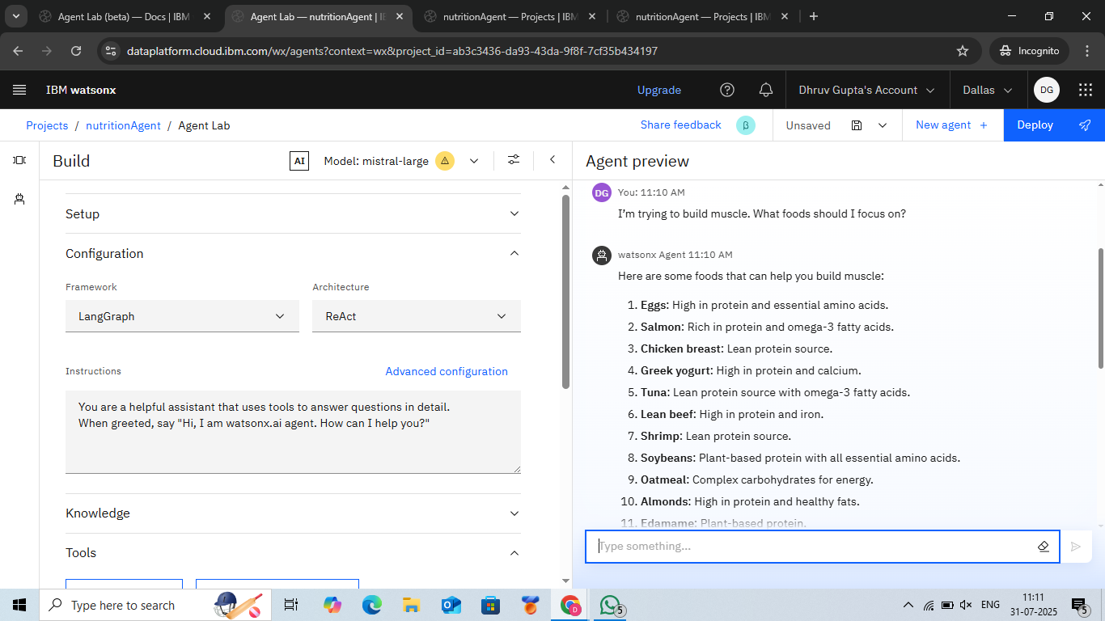
Results

Slide 9
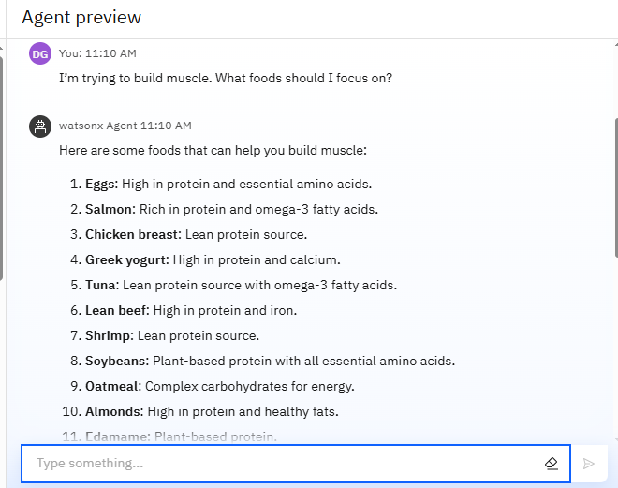
Results

Slide 10
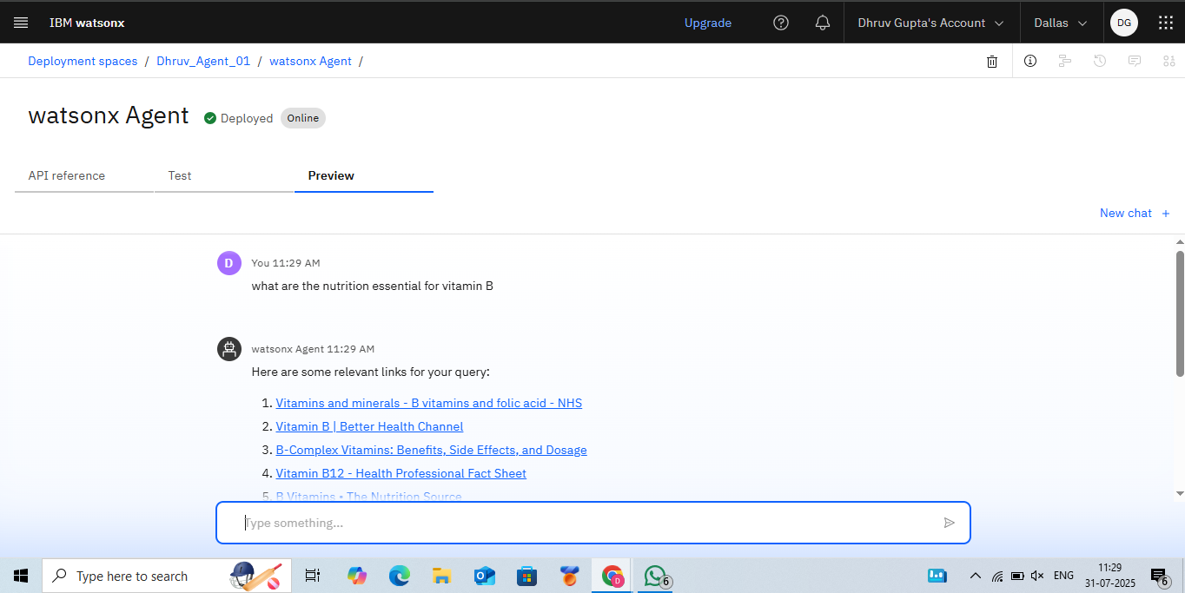
Results
Deployed AI Agent

Slide 11
Conclusion
The AI Nutrition Assistant successfully generates personalized meal plans tailored to complex user requirements.
It saves users time and uncertainty in planning their diet, automating a task that requires significant research and knowledge.
By making expert-level guidance scalable and adaptive, the agent enhances user efficiency, knowledge, and health outcomes in their nutritional journey.

Slide 12
Future scope
Wearable Integration: Sync with fitness trackers (Apple Health, Fitbit) to automatically adjust plans based on daily activity.Voice-Activated Research Assistant
Real-Time Visual Analysis: Allow users to take a photo of their meal for instant nutritional estimation and feedback.Research Gap and Novel Topic Identification
AI-Assisted Meal Logging: Simplify the process of tracking daily food intake.
Grocery List Generation: Create shopping lists from meal plans with options to export to e-commerce sites.

Slide 13
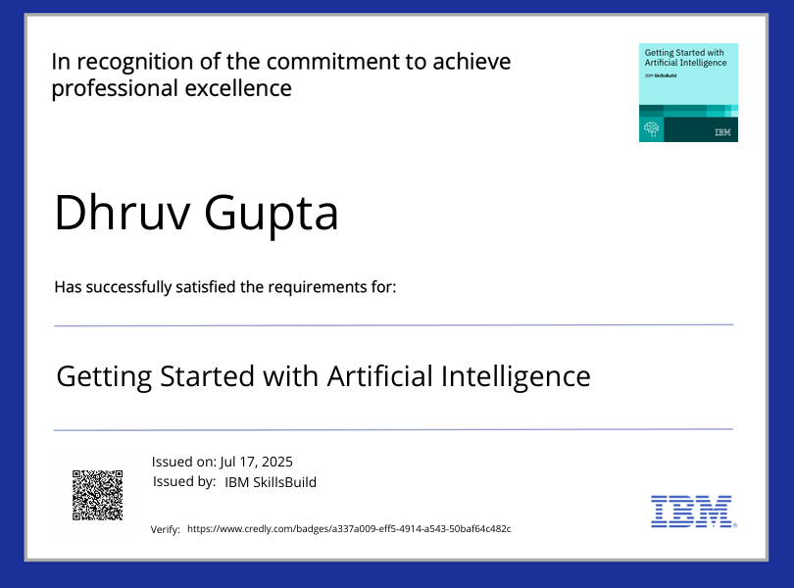
IBM Certifications
Getting started with AI

Slide 14
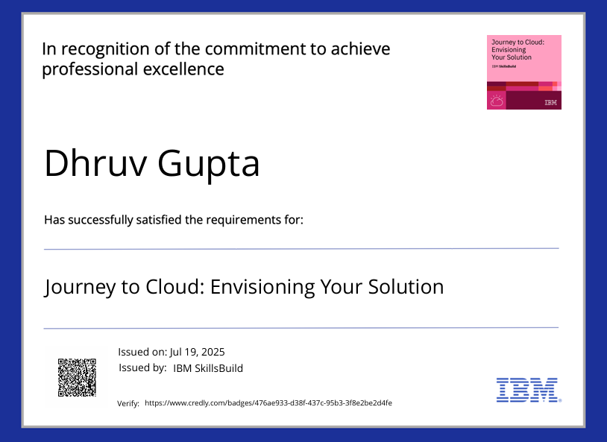
Journey to Cloud

Slide 15
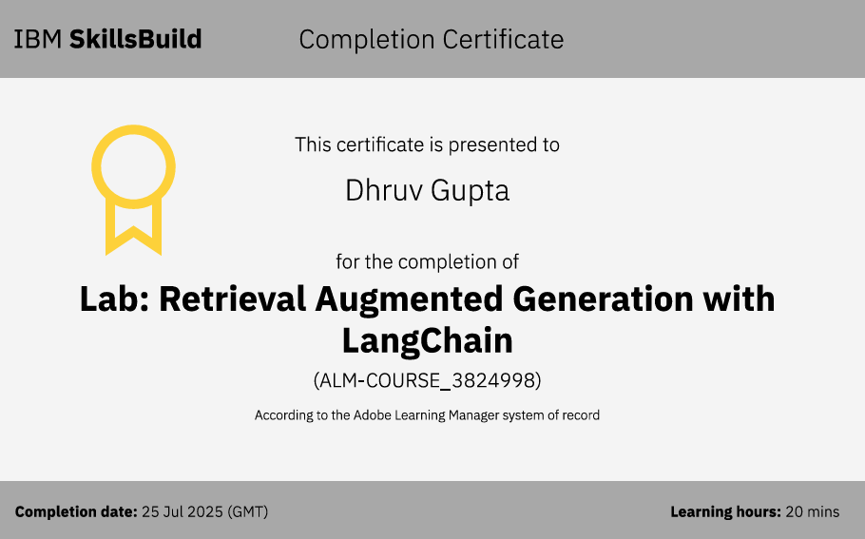
RAG Lab

Slide 16
GitHub Link
https://github.com/dhruvgupta2005/AI-Nutrition-Assistant

Slide 17
THANK YOU

